Slide 1

SMART HARD HAT BRIDGING SAFETY AND TECHNOLOGY
Mission :
To merge cutting-edge technology into solutions that improve worker safety and well-being various industries.
Team:
Chandini Nekkanti
Nitish Chilkamarri
Niranjan Anupati

Slide 2
USE CASES
The 56-year-old was pouring concrete when he fell and suffered life-threatening head injuries at a residential site at Doncaster East in Melbourne
As Fresno-area temperatures sizzled around 100 recently, a 59-year-old tomatillo field worker collapsed and died.

Slide 3
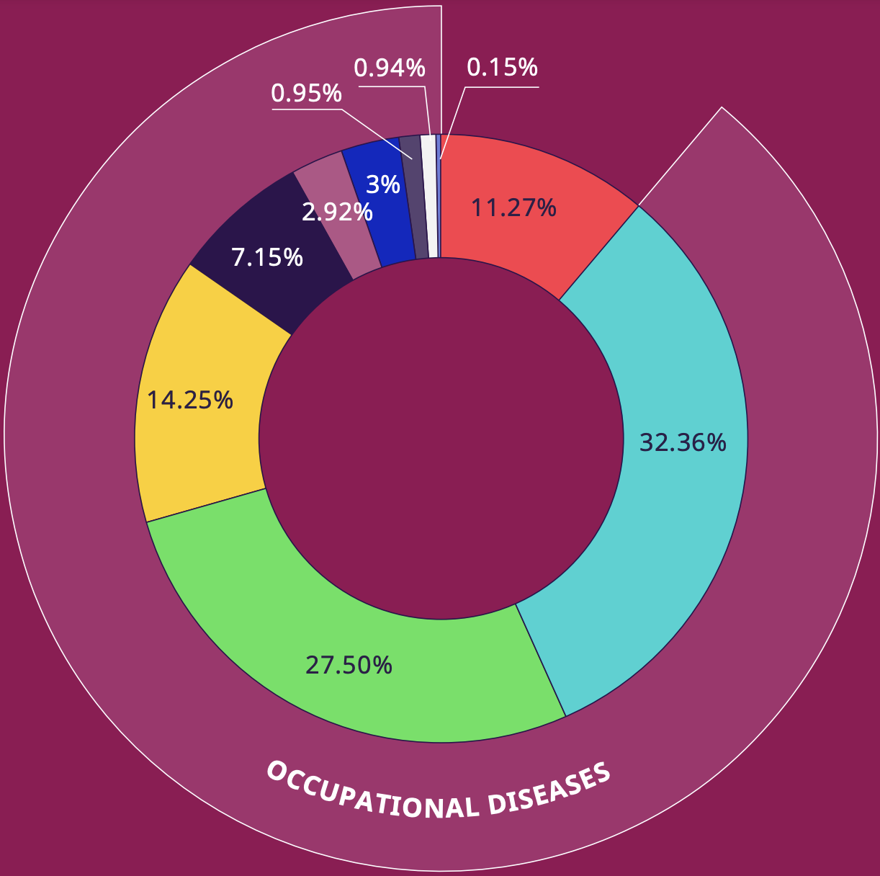
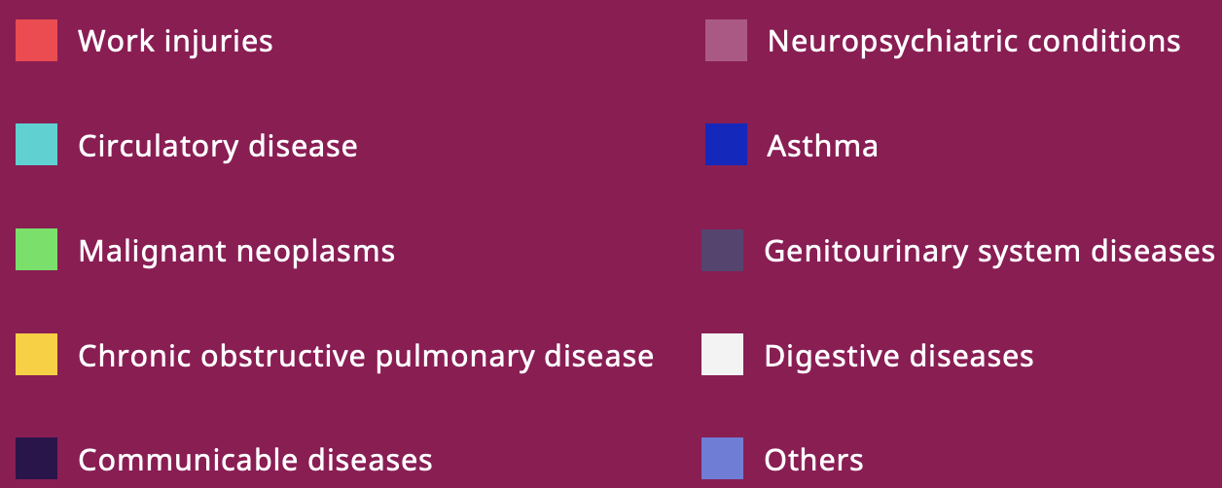
GLOBAL WORK-RELATED DEATHS
Nearly 3 Million people die of work-related accidents and diseases
Worldwide sustained non-fatal injuries alone effect 395 million workers
2.6 million stem from work related diseases and 330,000 account for work accidents
Source: ILO

Slide 4

UNMET: Current challenges in head protection safety equipment
Basic impact protection only: Hard hats miss crucial monitoring and injury prevention.
Environmental monitoring Gaps: Current PPE lacks real-time data on temp, humidity, air quality, risking worker exposure.
Communication challenges: Noisy sites hinder clear communication, impacting collaboration and safety.
Delayed Emergency response: Absence of panic buttons and fall sensors safety gear slows emergency assistance.
Limited Task Support: standard gear doesn't provide AR for task information, reducing efficiency and accuracy in operations.

Slide 5

The smart hard hat :A game-changer
A breakthrough in PPE: integrating cutting-edge technology into traditional safety gear.
Real-time monitoring: sensors for health and environmental alerts.
Clear communication: Robust two-way system for effective team coordination.
Emergency features: panic buttons and fall detection for enhanced safety.
AR for productivity: Augmented reality for efficient task handling.
Industry-specific Design: customizable to various industrial requirements
APP MONITORING: Health monitoring, Efficient user interface

Slide 6
USER INTERFACE & FEATURES
Intuitive Design: Easy-to-navigate interface, ensuring quick adaptability for new users.
Customization: Options for personalization to suit individual preferences and job requirements.
Real-Time Alerts: Clear, actionable notifications for environmental hazards and health monitoring.
AR Integration: Augmented Reality overlays for efficient task management and decision support.
Voice Activation: Hands-free control for enhanced convenience and safety on-site.
Hardware features:
Chin Strap
Magnetic attachments
Cooling vents
Padded sweatbands
Reflective stripes
Quick release buckle
Headlamp clips

Slide 7
COMPETITOR ANALYSIS
Feature | Smart Hard Hat | Techno soft Engineering | Airobot | Guardhat | Honeywell International | Studson
Biometric Monitoring | ✓ | ✓
Location Tracking | ✓ | ✓
IoT Integration | ✓ |  | ✓ | ✓
Voice Communication | ✓ |  |  | ✓
Emergency Buttons | ✓ |  |  | ✓
Durability | ✓ |  |  |  | ✓
Compliance with Safety Standards | ✓ |  |  |  | ✓
Customizability | ✓
Continuous Health Monitoring | ✓ |  |  |  |  | ✓

Slide 8
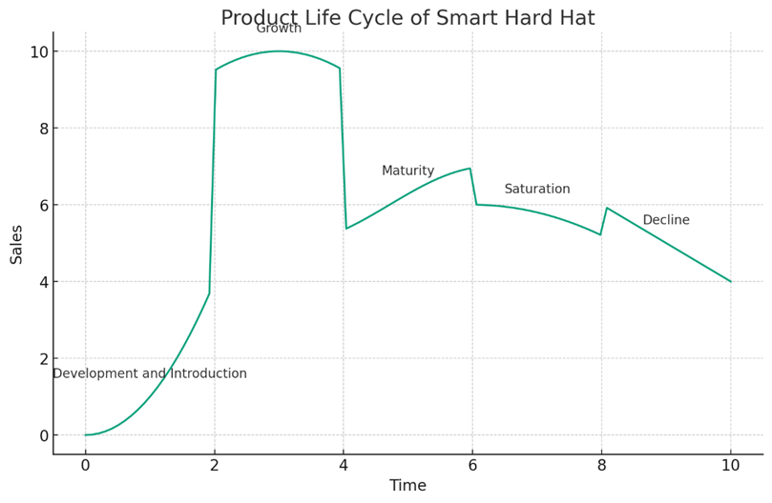
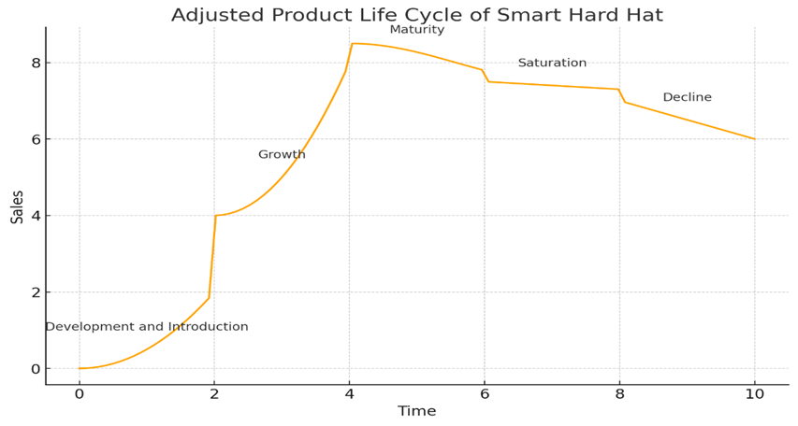
PRODUCT LIFE CYCLE

Slide 9
PRODUCT LIFE CYCLE
1. Development and Introduction: Early R&D and market introduction with low initial sales, focusing on design finalization and awareness.
2. Growth: Rapid sales increase as market acceptance grows, with intensified marketing and distribution expansion.
3. Maturity: Peak sales with stabilized growth; emphasis on differentiation and market share maximization.
4. Saturation: Slowing sales due to market saturation; strategies include cost-cutting, niche exploration, and feature enhancements.
5. Decline: Sales decline as market interest fades, leading to cost management, product phase-out, or pivot to new lines.

Slide 10
Design Considerations
MARKET SPECIFICATION
Safety Enhancement: Boosts safety in key industries with protective features and health monitoring.
Real-Time Data Collection: Offers biometrics, location, and environmental insights for variable conditions.
Communication and Connectivity: Ensures clear, seamless communication and data exchange on-site.
PRODUCT SPECIFICATION
Robust Communication: Equipped with a robust two-way system, ensuring over 500 meters of effective site communication, includes field validation.
Advanced Environmental Sensing: Features high-precision sensors for temperature, humidity, and air quality, requiring calibration and validation.
Durability and Material Quality: Utilizes HDPE or Polycarbonate for durability and comfort, with mandatory material testing for validation.

Slide 11
Design Considerations
DFMEA
Enhanced Communication: Mitigate signal failures with redundancy, testing, and training.
Environmental Sensing and User Interface: Enhance sensor reliability and user interaction with calibration, housing, and software checks.
Material and Battery Durability: Ensure durability with quality control and battery monitoring.
Emergency Response and Real-Time Location Tracking: Boost safety with dependable emergency features and GPS, ensuring regular testing and interference checks.
User Interface Design: Prevent malfunctions with usability testing, compatibility checks, updates, and user feedback for improved usability.

Slide 12
MARKET VALIDATION
$895 million U.S. safety helmet market
The global smart helmet market size is expected to reach USD 2,314.6 million by 2030, growing at a CAGR of 17.0% from 2023 to 2030
Source :Grand View Research Inc
Growing adoption of wearable technologies across globe
Rise in nation governments imposing safety laws
Companies stressing on Higher productivity of workers
Increasing safety and health concerns among people

Slide 13
Market Opportunity : Expansive market for the smart hard hat
Tapping into tech trends: the smart hard hat aligns with the rising demand for advanced PPE in construction and mining, leveraging the growth of IoT and wearable technologies
Unique Market Position: Its combination of real-time safety monitoring, effective communication, and AR-enhanced productivity differentiates it in the competitive PPE landscape.
Broad Appeal and Scalability: Customizable features cater to diverse industrial needs, indicating a wide market reach and potential for expansion

Slide 14
COST ANALYSIS
PART | COST ESTIMATE | INFORMATION
Temperature Sensors | $3 per sensor | Mid-range digital temperature sensor
Humidity Sensors | $3 per sensor | Mid-range humidity sensor (DHT22/AM2302)
Air Quality Sensors | $6 per sensor | Quality air quality sensor (MQ-7)
GPS Modules | $15 per module | GPS module (NEO-7M)
Biometric Sensors | $10 per sensor | Biometric sensor (GSR)
Microcontrollers | $15 per piece | Microcontroller (Arduino Nano)
Power Sources | $5.00 per module | Power source (Rechargeable Li-ion/Li-Po Batteries)
Additional Components | $10 (If any) | Higher quality additional components
Two-way Communication System | $10 | Communication module (4G LTE)
Labor and Assembly | $3( Per Product) | Labor cost in a semi-automated manufacturing location
Material (Exterior shell) | $10 | (Fiber-reinforced Polymers or Composites)
Overhead Costs | $65000 | Mid-range of overhead costs
Software Development and R&D Costs | $105000 | Assuming mid-range for software engineer salaries and R&D costs

Slide 15
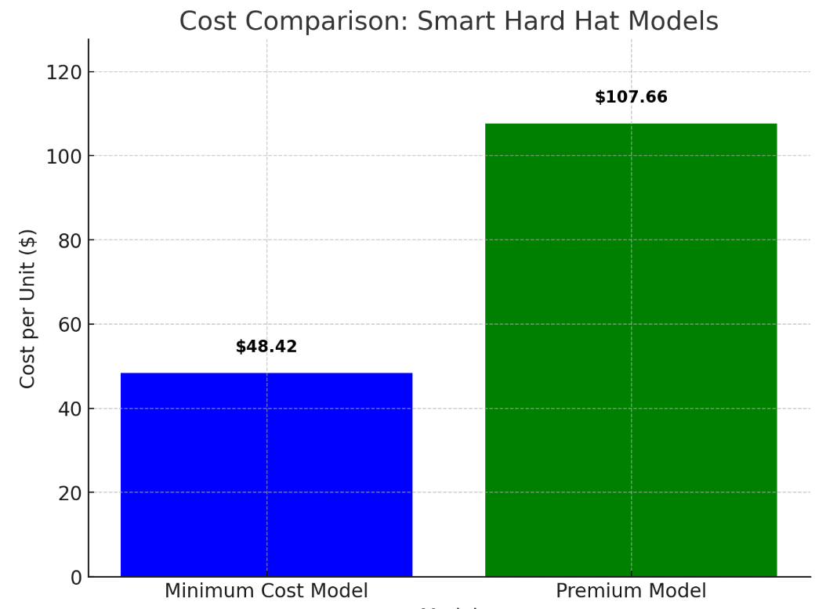
Unit Price Estimates for Smart Hard Hat
Minimum Cost Model: $48.42 per unit for the smart hard hat, assuming the lowest cost components, with an annual production of 50,000 units.
Premium Model: $107.66 per unit for the smart hard hat, using high-quality components at low prices, with an annual production of 50,000 units

Slide 16
Commercialisation Strategy
Early-stage network Building : Collaborating with market leaders at early stage of development and testing
Customization : Customising products specific to each customer needs(Adding or removing existing features)
Competitive Landscape: Collaborating with Regulatory boards and government agencies across
Nations/geographic locations where safety measures are not fully addressed.
Tailoring products to meet safety standards of each regulatory board.
Branding : Focusing on Safety enhancement, Health monitoring, Customisation
Continuous Improvement : Design iterations and modification for incorporating new technologies in the market or keeping up with changing regulations and new customer needs
Software Integration : Integrating our software with already existing company's Platform
Training : Providing training on software use and equipment best handling methods
Replaceable Items : Chin straps, suspension, Sweat bands, Snap in Accessories

Slide 17
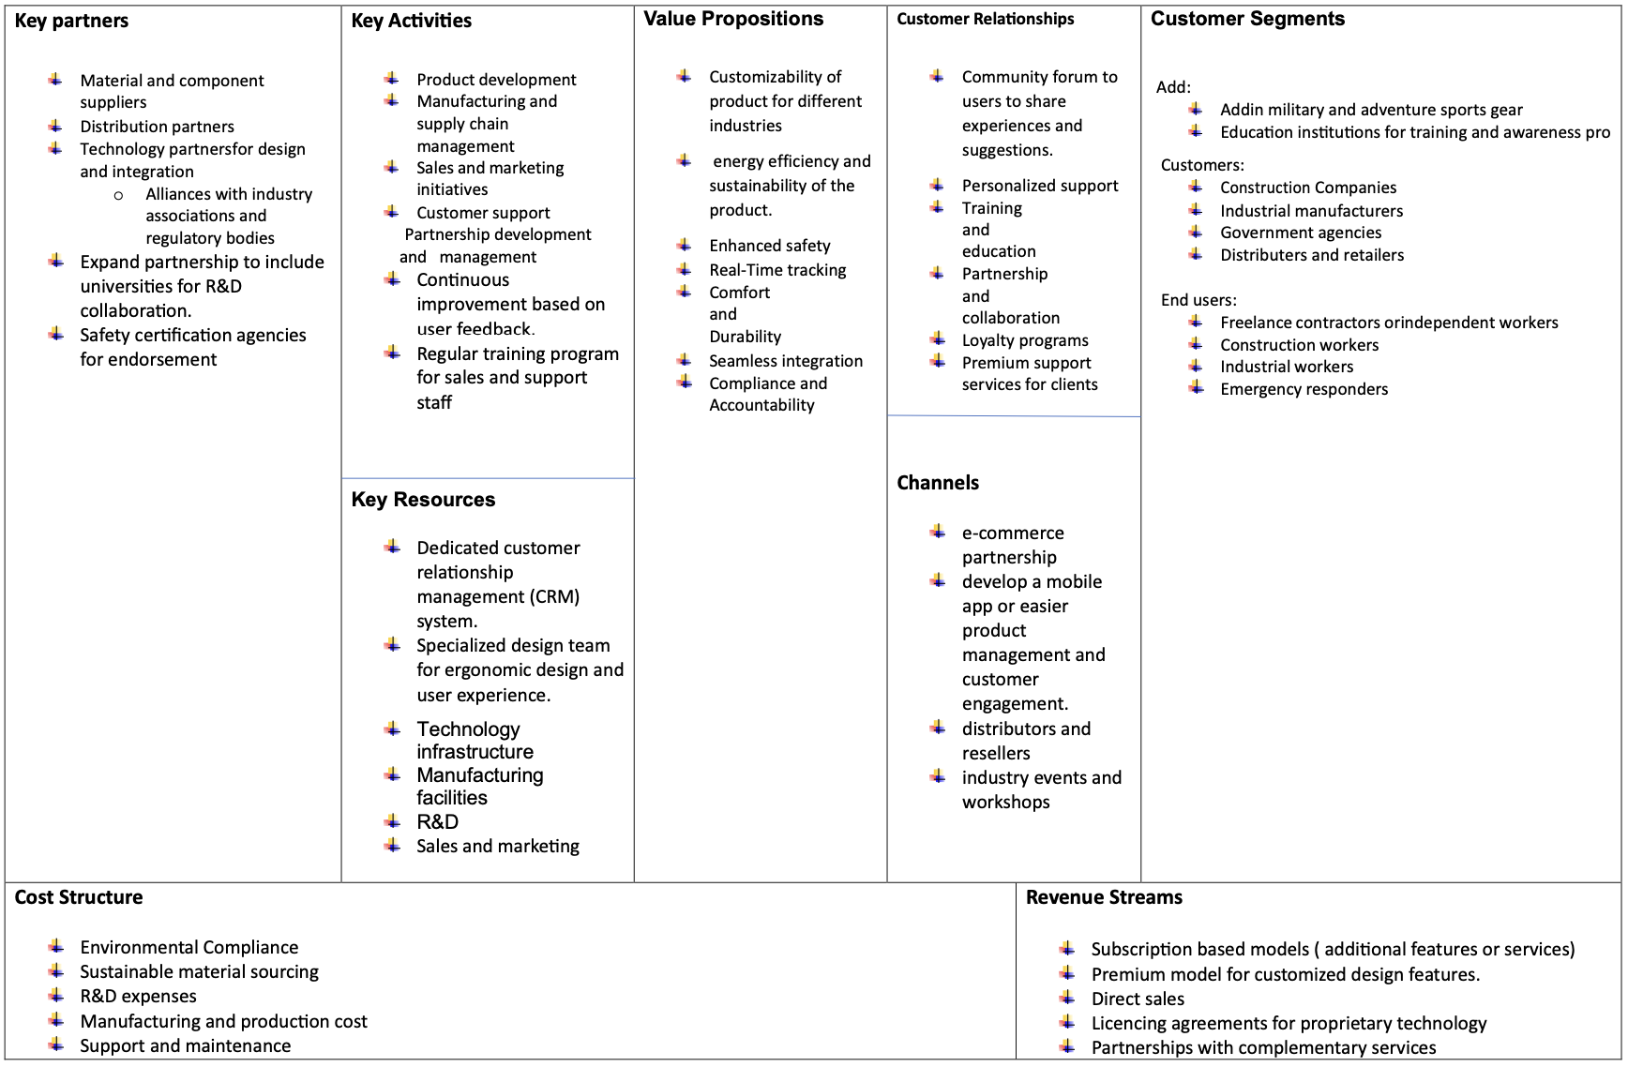
BUSINESS MODEL CANVAS

Slide 18
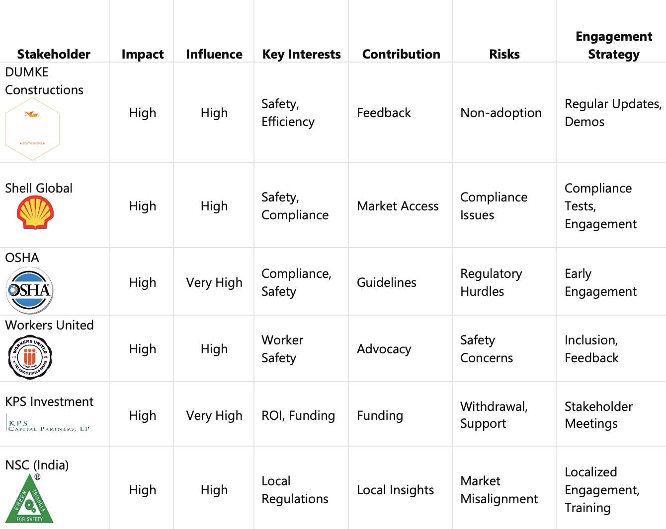
STAKEHOLDER MATRIX

Slide 19
Business Model and Sustainability
Product Development: Focused on continual R&D for technological and safety advancements.
Manufacturing & Supply Chain: Efficient processes and reliable sourcing to ensure quality and meet demand.
Sales & Marketing Strategy: Targeted campaigns in key sectors, highlighting the Smart Hard Hat's unique benefits.
Customer Support & Engagement: Robust support, training, and feedback mechanisms for strong customer relationships.
Continuous Improvement: Regularly integrating user feedback and market research to enhance product features.

Slide 20
PRODUCT ROADMAP
Quarter | Features | Goals | KPIs
Q2 2024 | Prototype Development & Initial Testing | Finalize design and develop initial prototypes for field testing | Number of prototypes developed, User feedback, Test completion rate
Q3 2024 | Pilot Program & Regulatory Compliance | Launch pilot program with industry partners and attain regulatory compliance | Number of pilot users, Compliance certificates obtained, User satisfaction score
Q4 2024 | Manufacturing & Marketing Strategy | Begin manufacturing and implement full-scale marketing strategies | Manufacturing units produced, Marketing campaign reach, Pre-order numbers
Q1 2025 | Market Launch & Customer Support | Official market launch and establishment of customer support infrastructure | Sales figures, Customer support tickets resolved, Market share

Slide 21
THANK YOU

